Slide 1
PUBLIC SERVICE
MOTIVATION RESEARCH:
LESSONS FOR PRACTICE
James L. Perry
Indiana University, Bloomington
and The University of Hong Kong
Geumgang University, November 7, 2016

Slide 2
PREVIEW
Motivation constructs: definition and measurement
Recent research activity
Public service motivation: state or trait?
Lessons from the research

Slide 3
WHAT IS PUBLIC SERVICE MOTIVATION?
Public Service Motivation
  An individual’s predisposition to respond to motives grounded primarily or uniquely in public institutions and organizations (Perry & Wise, 1990)
Altruism
  Motivation based on consideration of another’s needs rather than one’s own
Prosocial Motivation
  Desire to have a positive impact on other people, groups, and organizations

Slide 4
DEFINITIONS, continued
  The concepts converge around their emphasis on other orientation—represented by notions of self-sacrifice, altruism, and prosocial behavior

Slide 5
THEORECTICAL FOUNDATIONS FOR PSM
Predisposition-opportunity theory (Knoke and Wright-Isak, 1982)
Self-determination theory (Deci and Ryan, 2004)
Motivation-crowding theory (Frey and Jegen, 2001)
Institutions, public identity and self-regulation (Perry, 2000; Perry and Vandenabeele, 2008)

Slide 6
COMPARISONS OF ORIGINAL AND INTERNATIONAL SCALES
Perry, 1996 | Kim et al, 2013
Attraction to public policy making | Public participation
Commitment to civic duty/public interest | Commitment to public values
Compassion | Compassion
Self-sacrifice | Self-sacrifice

Slide 7
RECENT RESEARCH:
ARTICLE FREQUENCY OVER TIME

Slide 8
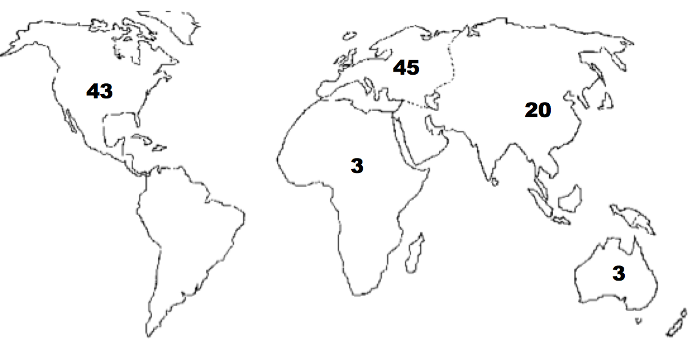
GEOGRAPHIC LOCATION OF STUDIES

Slide 9
RECENT KOREA STUDIES
Campbell (2015)
Christensen et al (2013)
Im, Campbell and Jeong (2015)
Kim, J. (2015)
Kim, T. (2015)
Lee (2013)
Lee and Kim (2014)
Park and Kim (2015)
Shim and Faerman (2015)
Shim, Park and Eom (2015)
Yeo (2016)

Slide 10
PUBLIC SERVICE MOTIVATION: STATE or TRAIT?
Is public service motivation a changeable individual attribute?
Trait, a stable individual difference, or
State, something experienced in the short run that fluctuates over time

Slide 11
PUBLIC SERVICE MOTIVATION: STATE vs TRAIT
What light do the research results reviewed here shed on the state—trait question?
Public service motivation is relatively stable over time
It can, however, change over time
PSM can also be “triggered” by stimuli or events

Slide 12
FIVE LESSONS
Give priority to selecting for high public service motivation
Create a supportive work environment that models and reinforces public service motivation
Leverage relationships between employees and service beneficiaries
Provide opportunities for newcomers to learn public service values
Develop leaders who communicate and model public service values
Notes:
(Joe Mazza) I am a PhD student with Walden University and a soon-to-be retiring police lieutenant who heads the bureau of internal affairs. It has been my experience that many police officer candidates are being selected for hire who appear less interested in public service than the public would like. I see this as a problem that contributes to inefficiency and police misconduct in all its forms.

Slide 13
LESSON 1: GIVE PRIORITY TO SELECTING FOR HIGH PUBLIC SERVICE MOTIVATION
Project organizational images to attract high public service motivation staff.
Take steps to screen in candidates with high public service motivation.
Take steps to screen out candidates with motivations likely to crowd out intrinsic or prosocial orientations.

Slide 14
LESSON 2: CREATE A SUPPORTIVE WORK ENVIRONMENT
Organizations that intentionally nurture public service motivation develop stronger ties between organization and employee values and goals.
Purging practices that crowd out public service motivation complements nurturing it.

Slide 15
LESSON 3: LEVERAGE RELATIONSHIPS BETWEEN EMPLOYEES AND SERVICE BENEFICIARIES
Design work for direct contacts between employees and beneficiaries.
When the importance of the public work is salient for employees but direct contacts are constrained, use self-persuasion or other types of self-administered interventions to connect employees to beneficiaries.

Slide 16
LESSON 4: PROVIDE OPPORTUNITIES FOR NEWCOMEERS TO LEARN PUBLIC SERVICE VALUES
On-boarding and orientation
Mentoring

Slide 17
LESSON 5: DEVELOP LEADERS WHO COMMUNICATE AND MODEL PUBLIC SERVICE VALUES
Articulating mission and vision
Value-based leadership

Slide 18
CONCLUSION
Two Inferences from Recent Research
    Uncertainties about traditional motivational assumptions
    PSM can be powerful
Coherent Management Strategies Using PSM Can be Designed
Better Attraction, Retention, and Performance are Likely Results

